Slide 1
Oncological perspective on Invasive lobular carcinoma
Anne Sofie Brems-Eskildsen
Department of Oncology, University Hospital of Aarhus

Slide 2
Guidelines in Oncology for ILC follows IDC
ASCO Guidelines for early breast cancer (not mentioned)
St. Gallen Guidelines for early breast cancer (not mentioned)
DBCG systemic treatment (not mentioned)
There is a lot of “myths” and expectations
We tends to consider the histology type in the daily clinic
Research area of growing international interest
Challenges in the oncologic treatment:
Chemotherapy?
Response to HER2 targeted therapy?
Considerations regarding radiotherapy?
Metastatic pattern and challenges
Notes:
When preparing this speach I have searched the guidelines for treatment of early breast cancer according to the specific histology type.
Both in the ASCO guidelines and in the St Gallen guidelines and also in our own Danish guidelines type of histology is not mentioned.
But we still tends to take the histology type into account when desiding the treatment.

Slide 3
Characteristics of invasive lobular carcinoma
5-15% of all breast cancers cases
Associated with
ER positive
Her2 normal
Large, multifocal growing tumors
Often lymph node negative
Slow growing, lower grade
Older women
Often diagnosed in a more locally advanced stage
The metastatic pattern are different.
Notes:
For a long time we have known that invasive lobular carcinoma have special characteristics. Looking back in the litterature I found an article from 2004 that descripet the exact same characteristic as is know to day.
They account for 5-15% of all breast cancer cases.
They are often ER positive and HER 2 normal.

Slide 4
Chemotherapy response?
Should we use neo-adjuvant chemotherapy in locally advanced breast cancer?

Slide 5
Response and prognosis after neo-adjuvant chemotherapy in 1,051 patients with infiltrating lobular breast carcinoma Sibylle Loibl et al
Breast Cancer Res Treat (2014) 144:153–162
One of the larges studies regarding response to chemotherapy is from 2014 and includes 1051 patients with ILC.
9020 patients were included in neo-adjuvant trials in Germany 11,7% were pure ILC
Neo-adjuvant chemotherapy is not effective in pure lobular cancer and the treatment should not be offered routinely
Upfront Aromatase inhibitor may be better? But no data so far.
 | ILC | Non-ILC
pCR rate (p=0,001) | 6,2% | 17,4%
pCR grade 1-2 ER negative or positive | 4,2%
pCR grade 3 or ER negative | 7%
pCR grade 3 and ER negative | 17%
Mastectomy pCR p= 0,037 | 27,4% | 16,6%
Mastectomy non-pCR p=0,0001 | 41,8% | 31,5%
Notes:
Results
Patients with ILC achieved a significantly lower pCR rate compared with non-ILC patients (6.2 vs. 17.4 %, P\0.001).
The pCR rate was 4.2 % in ILC/HR?/G1-2, 7.0 % in ILC with either HR- or G3, and 17.8 % in ILC/HR-/G3. Mastectomy rate was higher in ILC compared with non-ILC patients irrespective of response to NACT (pCR: 27.4 vs. 16.6 %, P = 0.037 and non-pCR: 41.8 % vs. 31.5 %, P\0.0001).
Age and HR independently predicted pCR in ILC.
Arguments:
Neoadjuvant chemotherapy is not effective in pure
lobular cancer and the treatment should not be
offered routinely
Upfront Aromatase inhibitor may be better.
Sibylle data: leading oncologist and CEO of the german researchgroup

Slide 6
Sibylle 2014: Higher frequency of mastectomy despite pCR
The mastectomy rate was considerably high in ILC patients even after obtaining a pCR.
They therefore, suggest to offer NACT mainly to ILC patients with HR-negative tumours
The indications should not be the shift in type of surgery

Slide 7
Sibylle 2014
No significant association between
pCR and better distant disease free survival (DDFS), but between pCR and overall survival.
Notes:
pCR in ILC did not predict distant disease free (DDFS) and loco-regional disease free survival (LRFS), but overall survival (OS).
Non-pCR patients with ILC had significantly better DDFS (P = 0.018), LRFS (P\0.0001) and OS (P = 0.044) compared with non-ILC patients.
Patients with ILC had a low chance of obtaining a pCR and this is not well correlated with further outcome.
The mastectomy rate was considerably high in ILC patients even after obtaining a pCR.
We, therefore, suggest to offer NACT mainly to ILC patients with HR-negative tumours

Slide 8
What about Trastuzumab?
HERA 2013
The HERA trial randomized between
1 year adjuvant trastuzumab vs observation in HER2 positive patients.
187 patients with ILC and 3213 patients with IDC
Notes:
A total of 187 ILC and 3,213 IDC patients were included.
The ILC and IDC subgroups had similar patterns of first site of disease relapse.
DFS hazard ratios (HRs) comparing 1 year of trastuzumab versus observation were 0.63 for ILC (95% CI, 0.34 to 1.15) and 0.77 for IDC (95% CI, 0.67 to 0.89; P for interaction .49).
The OS HRs comparing 1 year of trastuzumab versus observation were 0.60 for ILC (95% CI, 0.27 to 1.31) and 0.86 for IDC (95% CI, 0.71 to 1.06; P for interaction .29).
Conclusion In this retrospective analysis, there was no suggestion that patients in the ILC cohort experienced a different magnitude of benefit from adjuvant trastuzumab than those in the IDC cohort

Slide 10
Notes:
First, a diagnosis of lobular histologic subtype does not equal HER2 negativity and HER2 testing should be carried out
Second, patients diagnosed with early-stage, HER2- positive ILC should be offered 1 year of adjuvant trastuzumab. And finally, HER2-positive ILC treated with trastuzumab will derive a benefit of a magnitude similar to patients with the IDC histologic subtype

Slide 11
Trastuzumab and invasive lobular cancer:
First, a diagnosis of lobular histologic subtype does not equal HER2 negativity and HER2 testing should be carried out
Second, patients diagnosed with early-stage, HER2- positive ILC should be offered 1 year of adjuvant trastuzumab. And finally, HER2-positive ILC treated with trastuzumab will derive a benefit of a magnitude similar to patients with the IDC histologic subtype
And we expect the same in the neo-adjuvant setting.

Slide 12
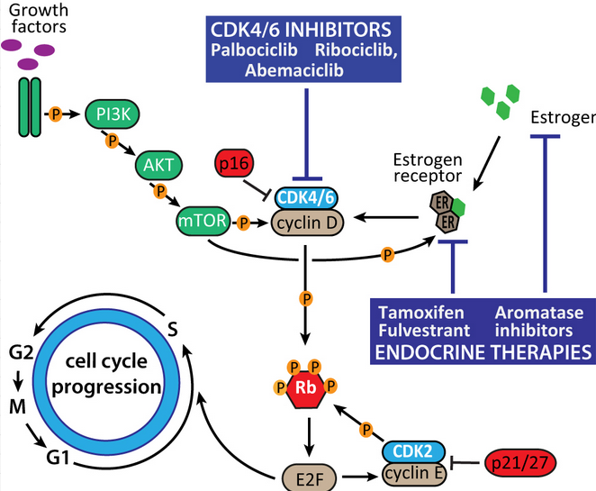
ER targeted neo-adjuvant therapy?
We can consider neo-adjuvant anti-hormone treatment in combination with CDK4/6 inhibitor treatment instead of chemotherapy.
Maximum response after 6-9 months.
But no randomized trials

Slide 13
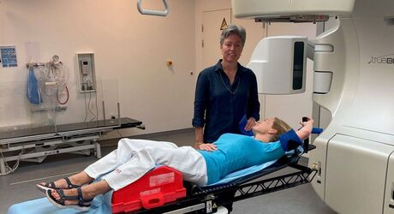
Adjuvant radiation therapy

Slide 14
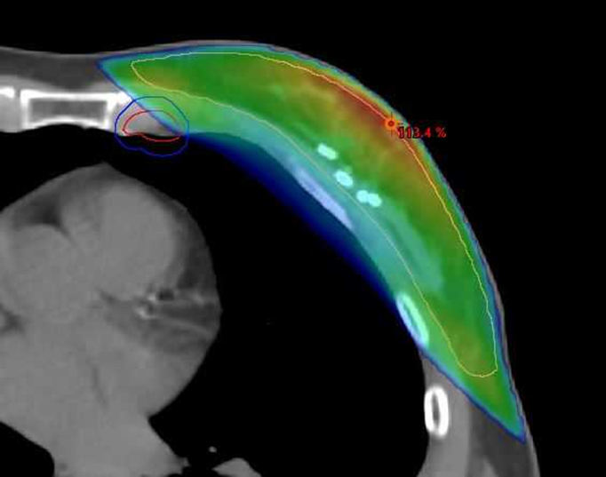
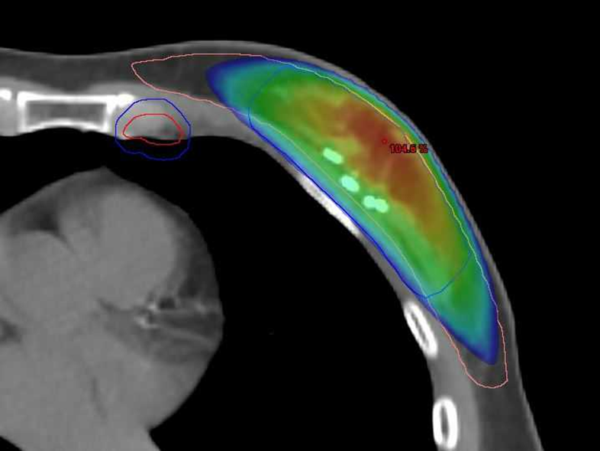
Higher risk of local recurrence and therefore lobular carcinomas are not included in partial breast radiation trials
Notes:
In the recent years there have been studies regarding reduced radiation therapy in patients with low risk of recurrence.
However the Invasive lobular carcinoma is an exclusion criteria
Due to risk of multifocality, occult in immages and

Slide 15
Radiation therapy considerations in lobular carcinomas
Risk of local recurrence after mastectomy was 18% compared with 6% for other types.
Radiation was given on the indication
(>5 cm tumor or macro metastasis)

Slide 16
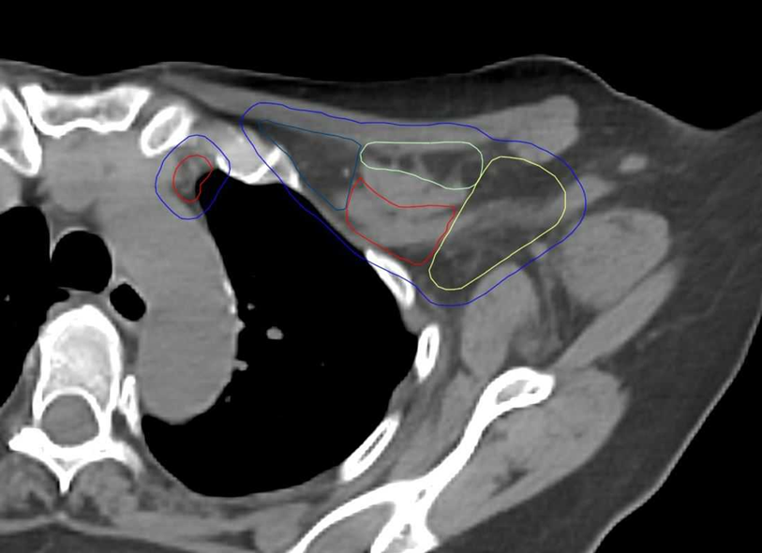
Nodal boost. Where is the target?????

Slide 17
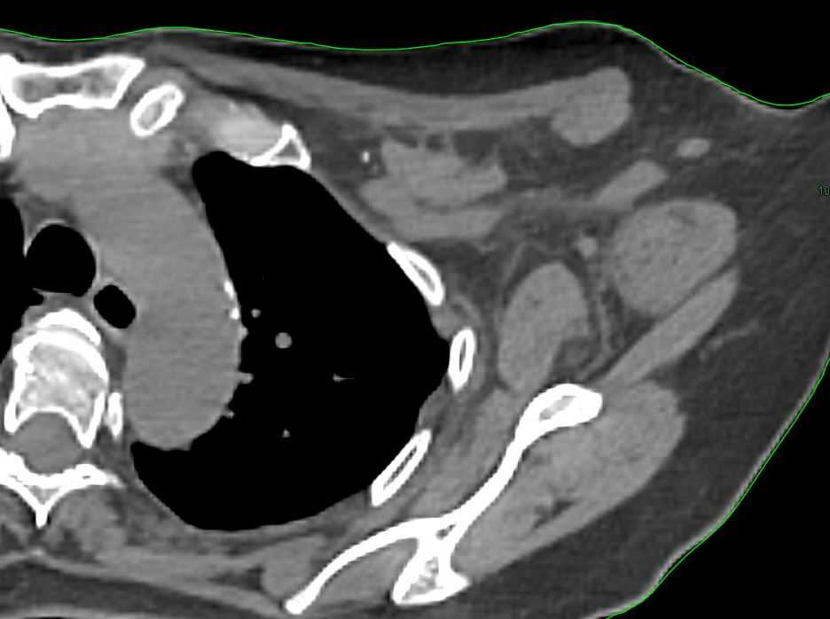
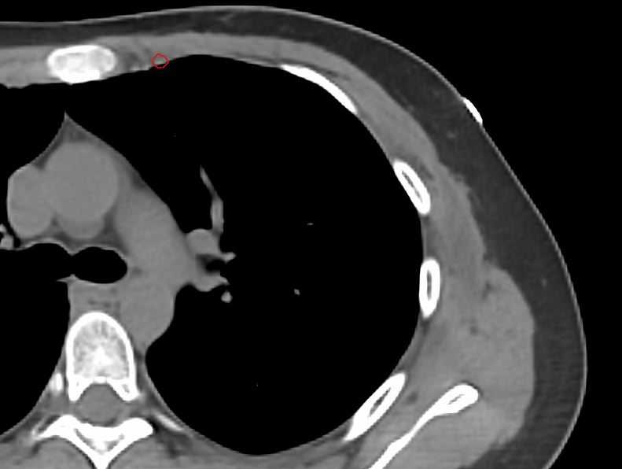
Where is the clip marked lymph node? Where is the known lymph node metastasis in the internal mammary gland? (IC2)

Slide 18
Metastatic ILC/IDC Treatment and outcome in metastatic lobular breast cancer in the prospective German research platform OPAL M. Thill1 · M.‑O. Zahn2 · A. Welt3 · E. Stickeler4 · A. Nusch5 · T. Fietz6 · J. Rauh7 · N. Wetzel8 · L. Kruggel8 · M. Jänicke8 · N. Marschner9 · N. Harbeck10 · A. Wöckel11 · T. Decker12 · the OPAL study group Received: 7 December 2022
2566 patients with metastatic breast cancer treated in Germany in routine care
2007-2021. n=466 ILC and n=2100 IDC
Characteristics of invasive lobular carcinomas:
Patients were older (median 69 vs. 63 years)
lower grade (G1/G2: 72.8% vs. 51.2%),
hormone receptor (HR)-positive (83.7% vs. 73.2%)
less often HER2-positive (14.2% vs. 28.6%) tumours,
metastasized more frequently to
the bone (19.7% vs. 14.5%)
peritoneum (9.9% vs. 2.0%)
less frequently to the lungs (0.9% vs. 4.0%)

Slide 19
Metastatic invasive lobular vs. invasive ductal carcinomas
Median OS:
metastatic invasive lobular carcinoma (n=209)
30.2 months
[95% CI 25.3, 36.0]
metastatic invasive ductal carcinomas (n=1158) 33.7 months
[95% CI 30.3, 37.9]
Multivariate survival analysis did not show a significant prognostic impact of the histological subtype HR mILC vs. mIDC 1.18 (95% CI 0.97–1.42)
Notes:
Analysed characteristics, treatments and outcome in 2566 patients (1367 with regard to OS) with mBC treated since 2007 in routine care
Patients with mILC represented about 15%
Patients with mILC presented at an older age, and their tumours were more likely to be of lower grade, HR-positive, and less likely to be HER2-positive compared to patients with mIDC.
Metastasize more frequently to the bone or peritoneum and less frequently to the lung

Slide 20
Conclusion
The guidelines regarding medical oncology in early breast cancer does not include histology type.
NACT is offered to patients with locally advanced invasive lobular carcinoma. Expect less effect.
In some cases can we consider neo-adjuvant treatment with anti-hormone/CDK4/6 treatment, but no randomized trials
Adjuvant chemotherapy is offed to patients with risk factors (like IDC)
HER2 positive tumors do benefit from HER2 targeting therapy
We will not offer partial breast radiation for patients with invasive lobular cancer
In the metastatic setting the cancer cells seems to have a preference to mucosa and peritoneum and we should be aware of clinical progression. (non-evaluable in RECIST)

