Slide 1
Targeted axillary dissection in Denmark
Frederikke Munck, MD, phd
Department of Breast Surgery
Herlev-Gentofte Hospital
Frederikke.munck.01@regionh.dk

Slide 2
TAD outcomes
Targeted axillary dissection
TAD non-identification
Ax-pCR
N⁺ at TAD
No ALND
ALND
ALND

Slide 3
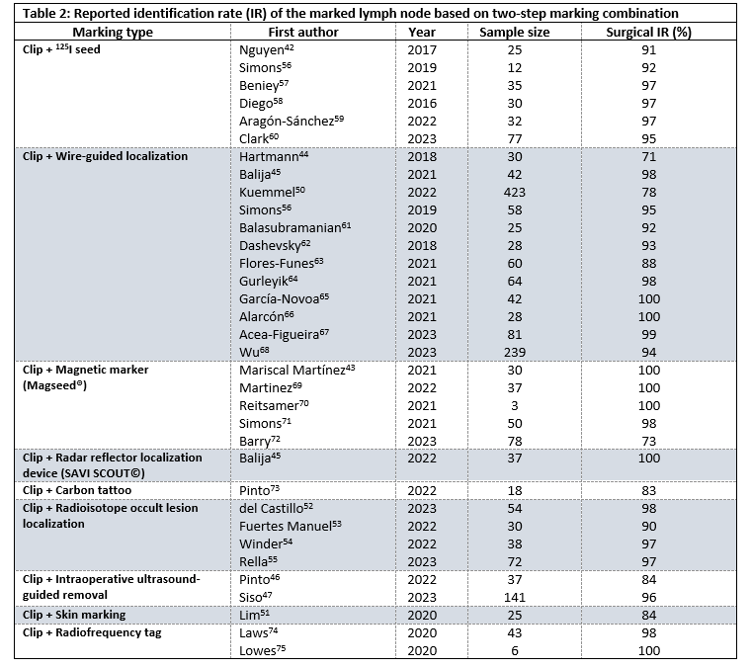
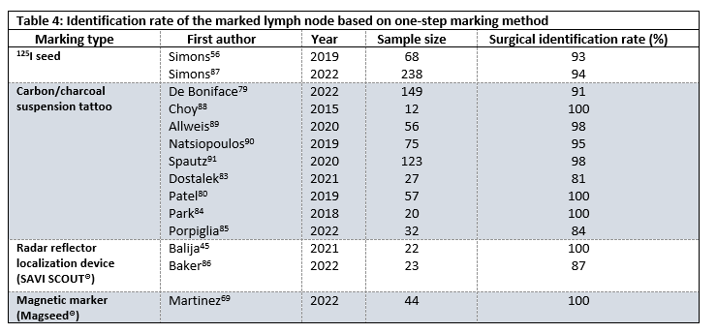
TAD outcomes
Targeted axillary dissection
TAD non-identification
ALND

Slide 4
TAD outcomes
Targeted axillary dissection
TAD non-identification
Ax-pCR
N⁺ at TAD
No ALND
ALND
ALND

Slide 5
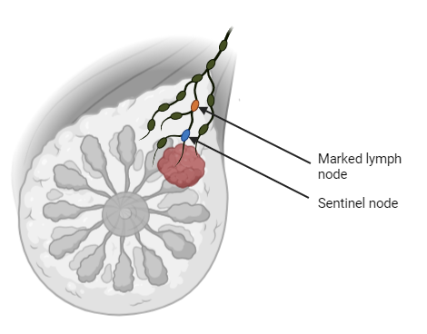
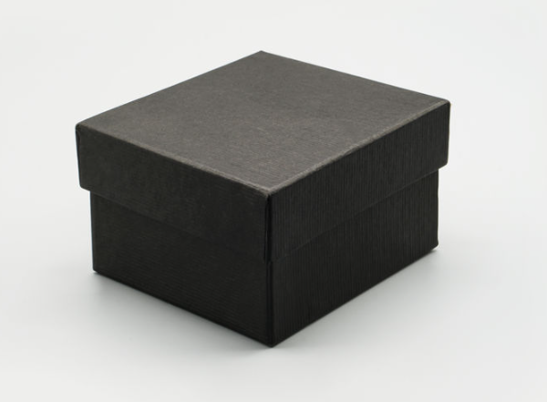
TAD outcomes
Targeted axillary dissection
With SLNB after NACT:
Macrometastases:
62-63% metastases to non-SNs
Micrometastases or ITCs:
17-64% metastases to non-SNs
N⁺ at TAD
ALND

Slide 6
Gaps and challenges
Reported surgical identification rate highly variable
Marking method with lowest non-identification rate?
Non-identification of marked lymph node warrants ALND
All metastases after NACT confer ALND
Which patients have limited axillary metastatic burden?

Slide 7
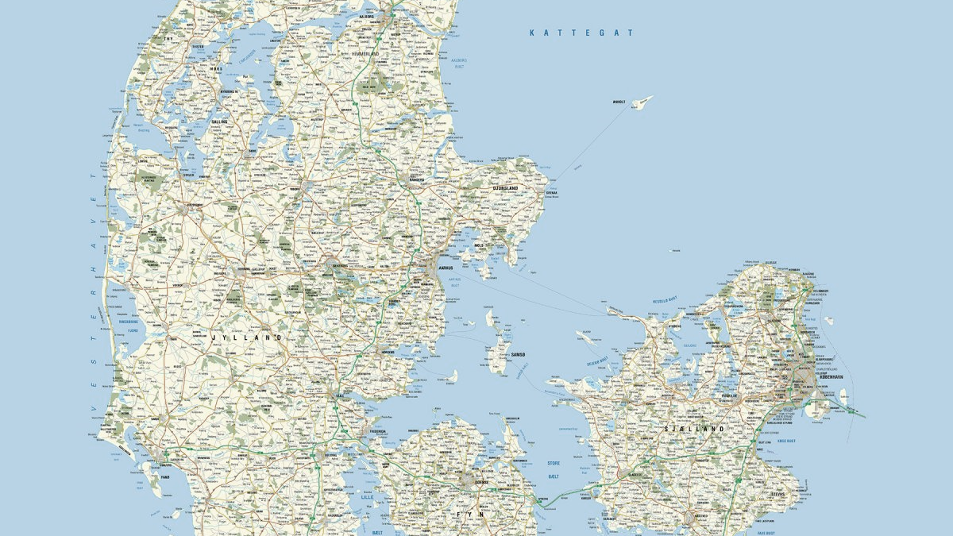
TAD identification rates in 685 patients
Marking method | n = 573 | Surgical success | OR (95% CI) | OR (95% CI)
Clip + Wire-guided localization | 263 | 90% | 2.5 (0.8-7.4) | Ref.
Clip with ink marking on skin | 103 | 82% | 5.3 (1.6-17.6)
Clip + iodine seed | 62 | 96% | Ref.
Clip + Magnetic marker | 3 | 100% | - | -
Iodine seed | 142 | 99% | 0.2 (<0.1-1.6) | <0.1 (<0.1-0.3)
n = 573
112 pts with clip marking at diagnosis
and no marking before surgery
87 pts w/ non-visualization
25 w/ other reasons
OR of non-visualization 2.1 (95% CI 1.3 – 3.4) with
axillary pathological complete response

Slide 8
TAD residual nodal burden
1626 patients
from DBCG data
Exclusion
ypN+ only
383 patients
in risk factor analysis

Slide 9
Positive TAD LN proportion |  | <.001
<66.6% | 0.34 (0.17-0.62)
66.6-100% | 1.00
TAD metastasis size |  | 0.02
Isolated tumor cells | 0.11 (<.01-0.82)
Micrometastasis | 0.68 (0.21-1.80)
Macrometastasis | 1.00
In breast at surgery |  | <.01
Breast pCR | 0.07 (<.01-0.56)
Breast non-pCR | 1.00
Factors associated with >3 non-TAD metastases in breast cancer patients with positive TAD LNs
Variable | Total | ≤3 positive non-TAD LNs | >3 positive non-TAD LNs | Univariate analysis OR (95% CI) | P^{b} | Multivariate analysis OR (95% CI) | P^{c}
 | N | N (%) | N (%)
 | 383 | 315 (82) | 68 (18)
Age |  |  |  |  | 0.17
≤49 | 158 | 135 (85) | 23 (15) | 0.69 (0.39-1.18)
≥50 | 225 | 180 (80) | 45 (20) | 1.00
Tumor size (diagnosis)ª |  |  |  |  | 0.054
<20 mm | 57 | 52 (91) | 5 (9) | 0.44 (0.16-1.01)
≥20 mm | 322 | 260 (81) | 62 (19) | 1.00
Malignancy grade |  |  |  |  | 0.49
Grade 1+2 | 291 | 237 (81) | 54 (19) | 1.00
Grade 3 | 92 | 78 (85) | 14 (15) | 0.80 (0.41-1.48)
Receptor subtype |  |  |  |  | 0.02
ER⁺/HER2⁻ | 229 | 182 (79) | 47 (21) | 1.00
ER⁻/HER2⁻ | 55 | 43 (78) | 12 (22) | 1.10 (0.53-2.19)
ER⁻/HER2⁺ | 22 | 18 (82) | 4 (18) | 0.93 (0.28-2.55)
ER⁺/HER2⁺ | 77 | 72 (94) | 5 (6) | 0.29 (0.10-0.68)
Positive TAD LN proportion |  |  |  |  | <.001 |  | <.001
<66.6% | 156 | 142 (91) | 14 (9) | 0.32 (0.17-0.59) |  | 0.34 (0.17-0.62)
66.6-100% | 227 | 173 (76) | 54 (24) | 1.00 |  | 1.00
TAD metastasis size |  |  |  |  | 0.005 |  | 0.02
Isolated tumor cells | 27 | 27 (100) | 0 (0) | 0.07 (<.01-0.52) |  | 0.11 (<.01-0.82)
Micrometastasis | 41 | 37 (90) | 4 (10) | 0.47 (0.15-1.17) |  | 0.68 (0.21-1.80)
Macrometastasis | 315 | 251(80) | 64 (20) | 1.00 |  | 1.00
In breast at surgery |  |  |  |  | <.001 |  | <.01
Breast pCR | 35 | 35 (100) | 0 (0) | 0.06 (<.01-0.42) |  | 0.07 (<.01-0.56)
Breast non-pCR | 348 | 280 (80) | 68 (20) | 1.00 |  | 1.00

Slide 10
Patient path
Diagnosis/work up
Neoadjuvant treatment
Surgery
Long term follow-up
Marking method
Axillary de-escalation groups

Slide 11
Is TAD safe?

Slide 12
Oncological outcomes
DBCG:
ypN0 TAD patients w/o ALND (n = 301)
Previous malignancies excluded (n = 12)
Outcomes:
Regional nodal recurrence
Overall survival
Left-truncation to day 201 (n = 6)
Characteristics of 283 ypN0 patients staged with TAD
Age | n (%)
<30 yrs | 7 (2.5)
30-49 yrs | 127 (44.9)
50-69 yrs | 111 (39.2)
≥70 yrs | 38 (13.4)
Tumor size at diagnosis (US)
<20 mm | 63 (22.2)
≥20, <50 mm | 181 (64.0)
≥50 mm | 39 (13.8)
Clinical nodal stage
cN1 | 272 (96.1)
cN2-3 | 11 (3.9)
Estrogen receptor status
Positive | 150 (53.0)
Negative | 133 (47.0)
HER2 receptor status
Positive | 183 (64.7)
Negative | 100 (35.3)
Estimated potential median follow-up: 42.1 months (IQR: 31.4-56.0 months)
Notes:
RNR: 3 events, alle havde synkrone fjernmetastaser
CE: Død (4), kontralateral BC (2), fjernmetastaser (11), anden malign sygdom (5), lokalrecidiv (3)
cN3 pts: 1 fjernrecidiv (CNS)
STEEP: ipsilateral axilla, supraclavicular, internal mammary regions

Slide 13
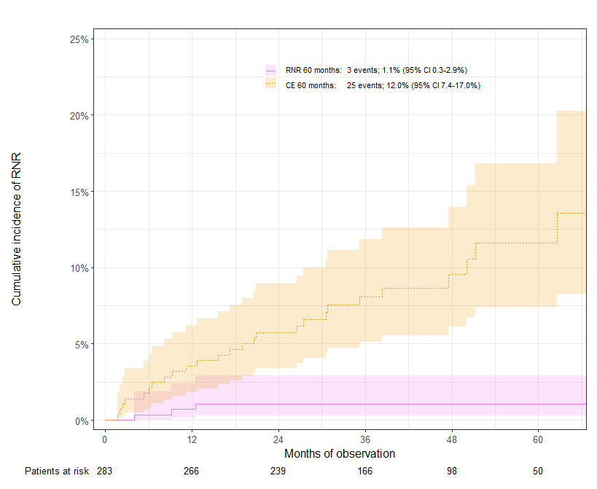
Regional nodal recurrence
5 Year follow-up | TAD | N0 (n = 15,784)
RNR (95% CI) | 1.1% (0.3-2.9%) | 0.69% (0.56-0.84%)
CE (95% CI) | 12.0% (7.4-17.0%) | 11.58 (11.02-12.14%)
Estimated potential median follow-up: 42.1 months (IQR: 31.4-56.0 months)

Slide 14
Overall survival
Estimated potential median follow-up:
52.2 months (IQR: 39.3-67.6 months)

